Slide 1
Machine Learning Bootcamp Project Report
DILSHAD RAZA
23JE0574

Slide 2
Linear Regression
At first, I implemented gradient descent with multiple nested ‘for loops’ because of which my code was taking too much time to run.
I chose the cost function to be Mean Squared Error.
Also, the first data set that was given to us contained many outliers which made it difficult for my model to get trained. I tried removing outliers by defining an outlier example as the one which has y_label > (mean + 3*std_dev) or y_label < (mean – 3*std_dev).
Then the data set was changed for which my MSE cost saturated at close to 0.005.
My non-vectorized code was taking 3 minutes for 100 iterations.
I vectorized my code and then it took 2 seconds for 1000 iterations.
As for learning rate I first chose 0.1, cost saturated after 120 iterations. Then I chose learning rate as 1 and then it saturated after 10 iteration only.
So I chose the value of learning rate as 1.
As I was getting 0.99999 as R2_score on cross-validation, I used regularization parameter as 0.

Slide 3
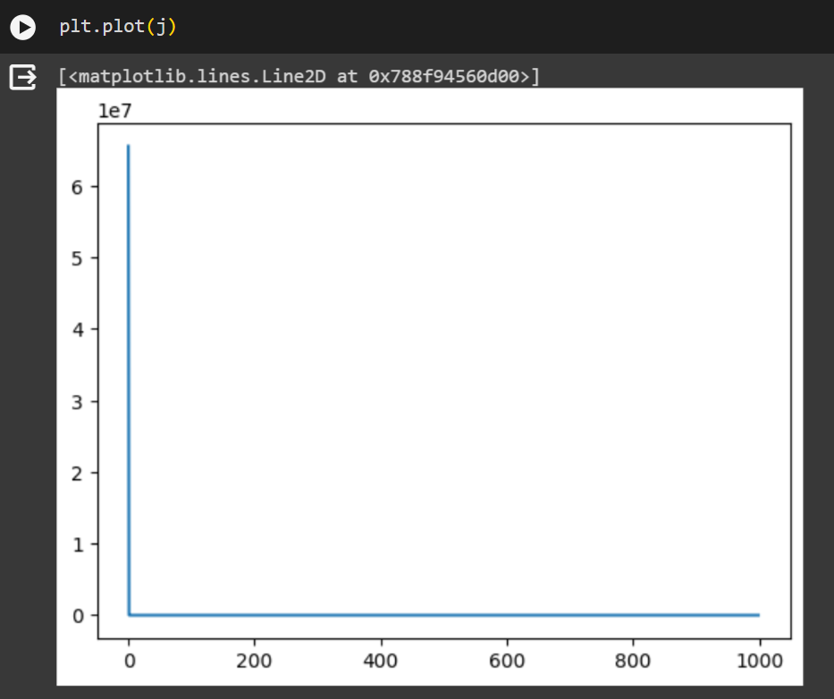
Graph of cost vs iterations.

Slide 4
Polynomial Regression
Initially, I made my model with powers of only one example like (x1)^2, (x2)^1, (x3)^4 etc. My degree 5 model will include all the terms up until degree 5.
I implemented gradient descent with nested ‘for’ loops because of which it was talking too much time initially.
My cost(MSE) was also coming very very high for degree 5 onwards (>10^25).
I then changed my model to one in which it has all the terms of a multinomial expansion. Ex:- (x1)^2*(x2)^3*(x3)
I also vectorized my code as much as possible, in functions of cost and gradient, which reduced execution time significantly(67s for 1000 iterations of all 10 models upto degree 10 combined).
I used the learning rate of 0.1 first, for which degree 10 overshooted. Then I used 0.08 which showed the same result. But for 0.05, it worked fine.
I encountered errors of ‘shape not matched’ in taking dot products.

Slide 5
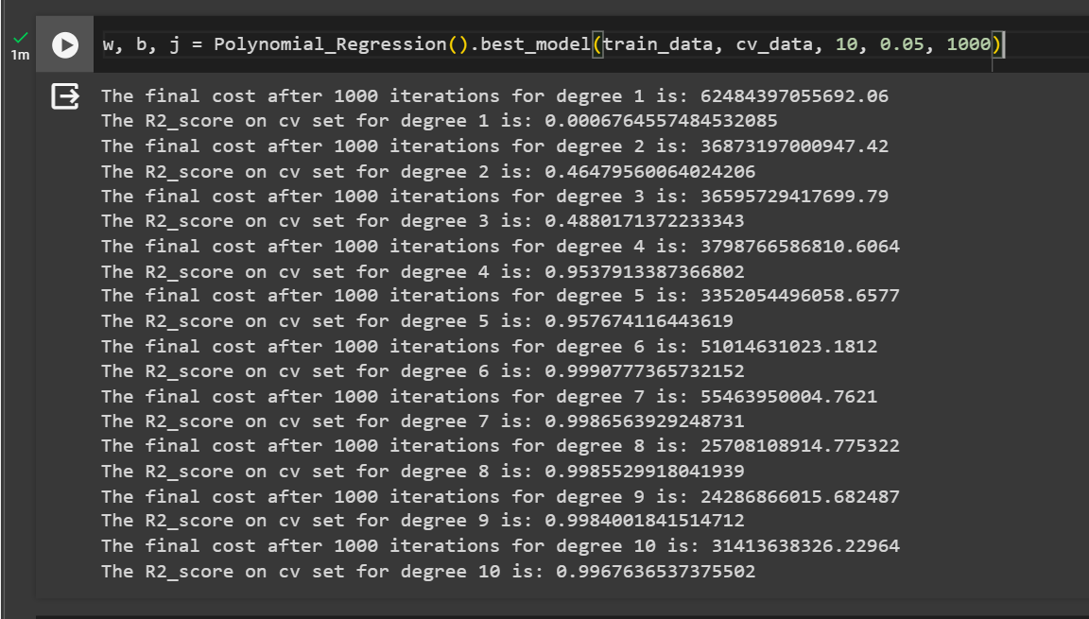
Cost on training data after 1000 iterations and R2_score on CV data for models upto degree 10.

Slide 6
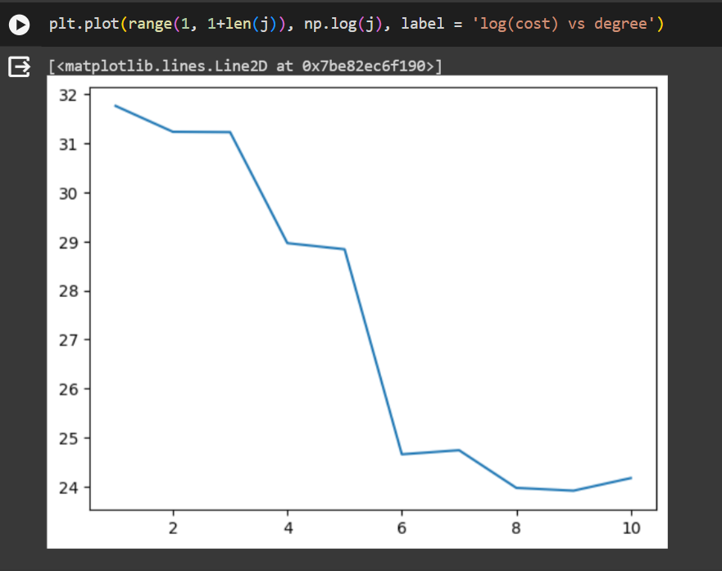
This is the graph of logarithm of cost vs degree. We can see there is a sudden fall in cost for degree 6.

Slide 7
From the previous graph, I concluded that the degree 6 fits the data just fine.
I attained the R2 score of 0.999 in cross validation set.
Since, I was getting good results on cross validation set, I didn’t include regularization parameter.

Slide 8
Logistic Regression
Previous Code:
I first implemented softmax regression as the task was of multi-class classification. Used categorical crossentropy cost function.
I vectorized my code only after mid-evaluation.
The non-vectorized implementation of softmax regression was taking 5 minutes 25 seconds to run for 500 iterations and I achieved R2 score of 0.965.
The cost saturated after 400 iterations for learning rate 0.02. I tried learning rate 0.1 first at which the cost was jumping, same goes for 0.05.
I have comment out all the code of this implementation in my final code.
Current Code:
I was told to implement one vs all logistic regression.
My model works in a way that the first model would detect if an example belongs to a particular class or not and so on. So basically I made K number of models for K number of classes.

Slide 9
I scaled down the features by dividing with maximum value (255) just to overcome overflow.
I did silly mistakes like not scaling down the cross validation set because of which the correct predictions I was getting was 0.
Since I was facing overshooting in soft-max regression I started with learning rate 0.02 for this model. Hence the learning was slow and I was getting less accuracy even for 500 iterations.
So I gradually increased my learning rate up untill 2 after which the results were more or less the same. For learning rate 2 and iterations 300, the accuracies are given in next slide. I concluded my learning rate as 2.
This implementation took 1 minute to run for 300 iterations.

Slide 10
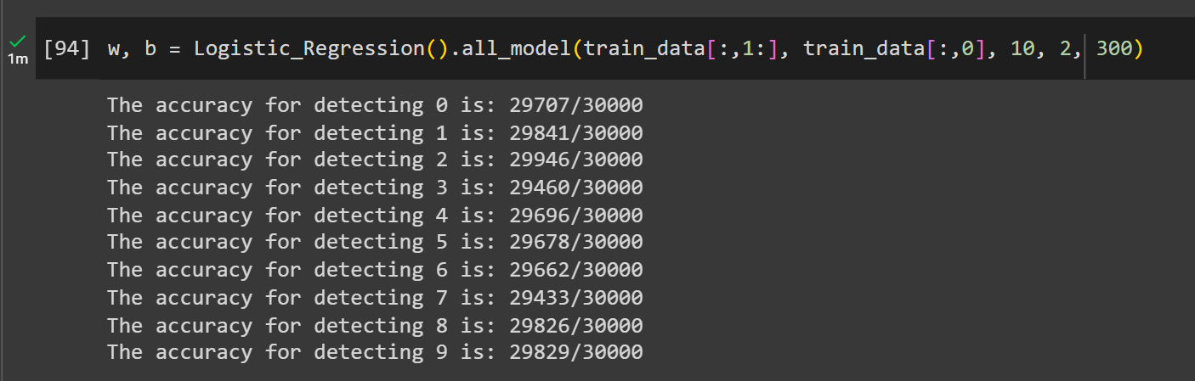

Slide 11
K-Nearest Neighbours
My Previous Code:
Distance that I’m using is Euclidean distance.
I calculated the distances of each test example with respect to each training example using loops and then took the indices of ‘K’ minimum distances.
For training data of size 5000 and test data of size 1000, it took 95 seconds to execute for just one value of K.
My Current Code:
I vectorized the function of computing distances of each test example with respect to each train example.
I implemented by first writing the expanded form of distance formula between two data points.
For training data of 25000 and test data of 5000, calculating the distances is taking close to 5 minutes, while for getting K nearest neighbours and predicting labels is taking 40 seconds for k=1 to k=50.
The accuracy was highest for K=1 and gradually decreased as K increased. I decided to keep the value of K as 1.
I was facing issue with how to find the indices of first k neighbours. I tried finding numpy methods for this, I found np.argpartition.

Slide 12
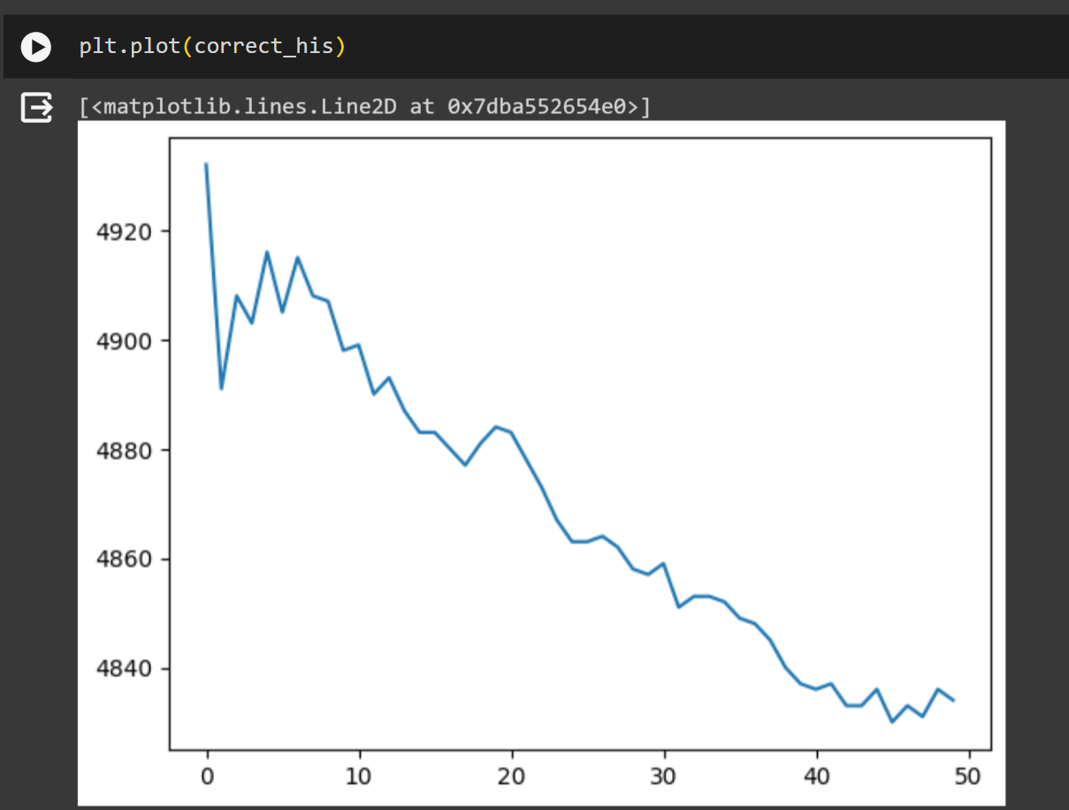
Correct Predictions(out of 5000) vs K

Slide 13
For counting the frequencies of each class, I used np.bincount.
I am getting accuracy of 98.4% on cross validation set.

Slide 14
Neural Network
I spent most of my project time in studying Neural Network’s functioning and implementing back-propagation.
I tried looking for resources for Neural Networks and I came across a book ‘Neural Networks and Deep Learning’ by Michael Nielson.
I read the first few chapters of this book, which covered fundamentals of back-propagation and optimization of neural networks.
My First Approach:
In my first approach, I made my neural architecture as [784, 50, 10]. I used sigmoid activation function for both hidden layers and last layer. Cost function as quadratic cost.
Why I chose quadratic cost?? Because at first I wanted to make the simplest model of neural network and then make changes gradually. This is also the reason why I chose activations of all layers as sigmoid.
I initialized my weights and biases randomly with gaussian distribution with mean to be 0 and standard deviation to be 1. I used mini-batch gradient descent with a batch size of 10.
At that time, I back-propagated only one example at a time, because of which it was taking much time to run. (30 minutes for 10 epoch, with training data of 25000). I achieved accuracy of 0.944(on cross validation data of size 5000) with this model.

Slide 15
Second Approach
I changed my activation for hidden layers to ReLU, and softmax for output layer. My cost function as categorical crossentropy.
I vectorized my back-propagation which significantly decreased the time taken to execute.
At first, I didn’t scaled down the features and hence I encountered the error (RuntimeWarning: invalid value encountered in divide). So I scaled down the value of features by a factor of 255. Then it encountered overflow, so in softmax function before taking exponentials of z I subtracted the maximum value of z.
I didn’t experiment much in the architecture of neural network for the first model. But for this one, I tried changing the number of neurons in the hidden layer to 20, 25, 30, 35, 40. But I got the best result for 30 neurons in the only hidden layer.
I also tried adding more hidden layers(such as [784, 30, 20, 10]) but it was giving less accuracy.
I first initialized my weights, biases with normal distribution and then switched to He initialization and I achieved convergence at fewer epochs(14-15).
I also studied about the derivation of He’s initialization.

Slide 16
I also tried experimenting with batch size, I got the best result for batch size of 10.
As for learning rate, I first used 0.1 for which the accuracy was increasing gradually.
Then I tried 0.5 for which accuracy decreased, I got best result for learning rate of 0.2. So I concluded learning rate as 0.2.

Slide 17
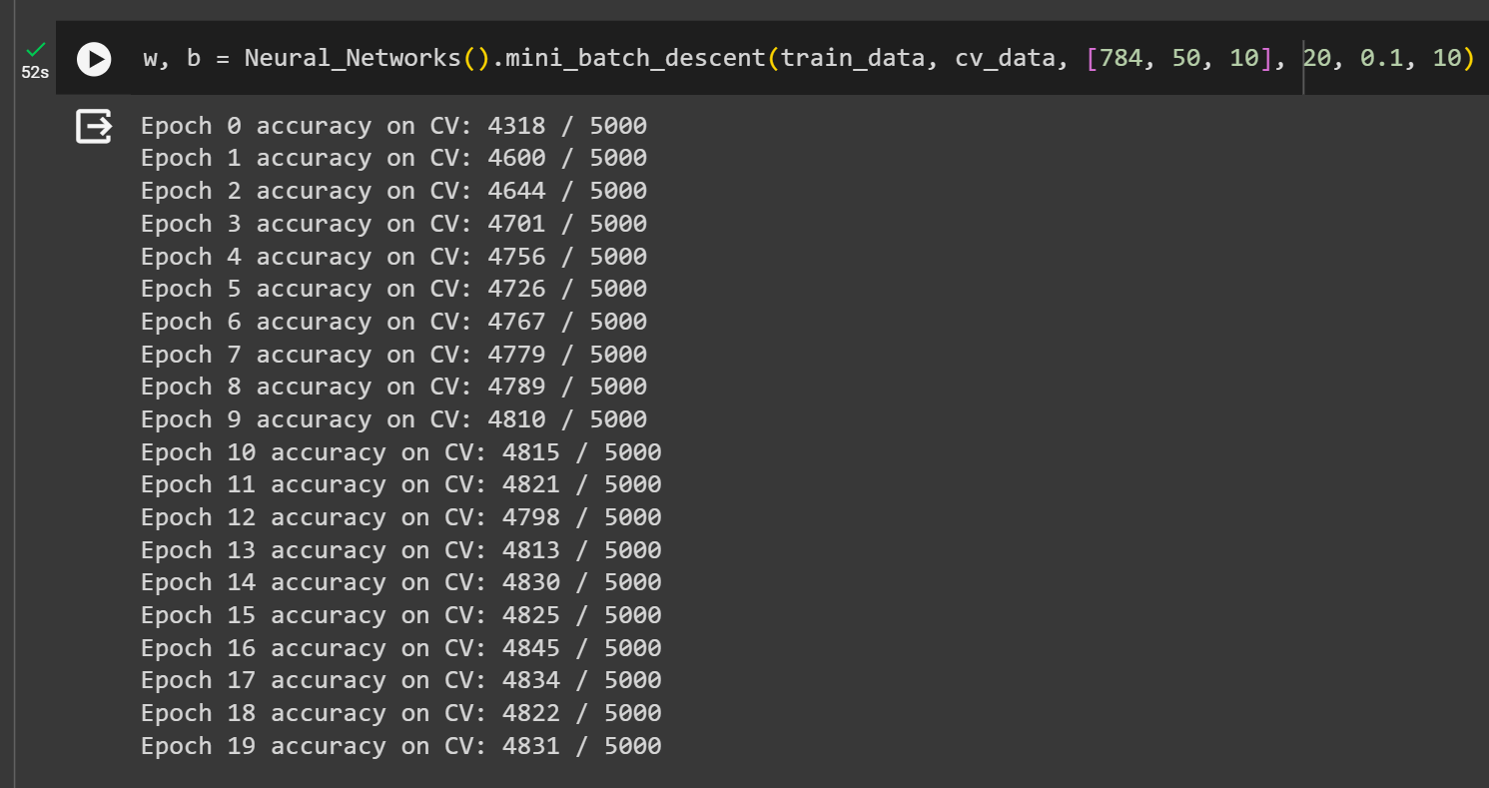

Slide 18
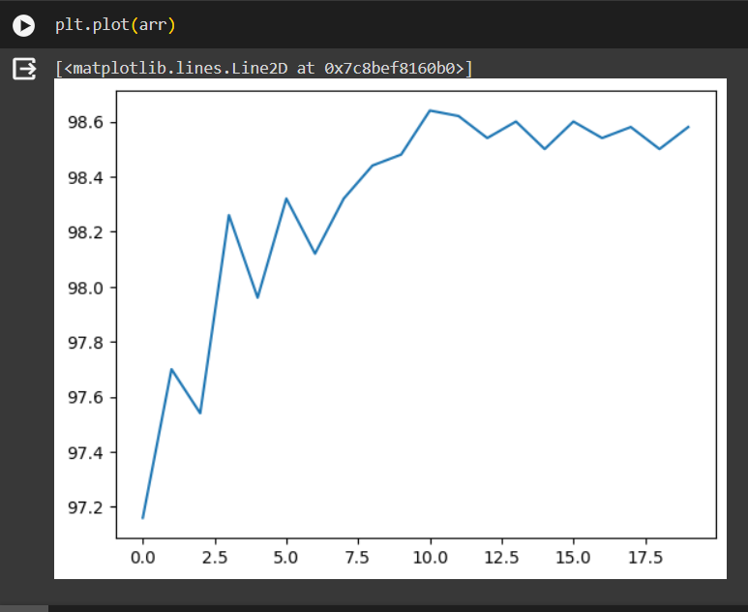
Graph of correct accuracy vs epoch

Slide 19
K-Means Clustering
I used Euclidean distance for calculating distances between two points.
I was calculating distances with loops first. Since the data-set that was given to me was not that big, it didn’t take much time.
I was able to vectorize the distances function by rewriting every term on my copy.
I normalized the data since the features were not in the same scale. So that each feature has equal contribution or importance in calculating distances. I used the z-score normalization for this.
I tried visualizing the data by plotting the data-points between any two feature but I didn’t get a hint at all about the number of clusters.
I initialized the centroids by taking k random points as the centroids. I am initializing 10 times so that the initial centroids are chosen in 10 different ways.
I used elbow method for determining the number of clusters. i.e plotting the mean distances of data points and assigned clusters with respect to different values of k.
There was clear elbow at k=3. I concluded number of clusters as 3.

Slide 20
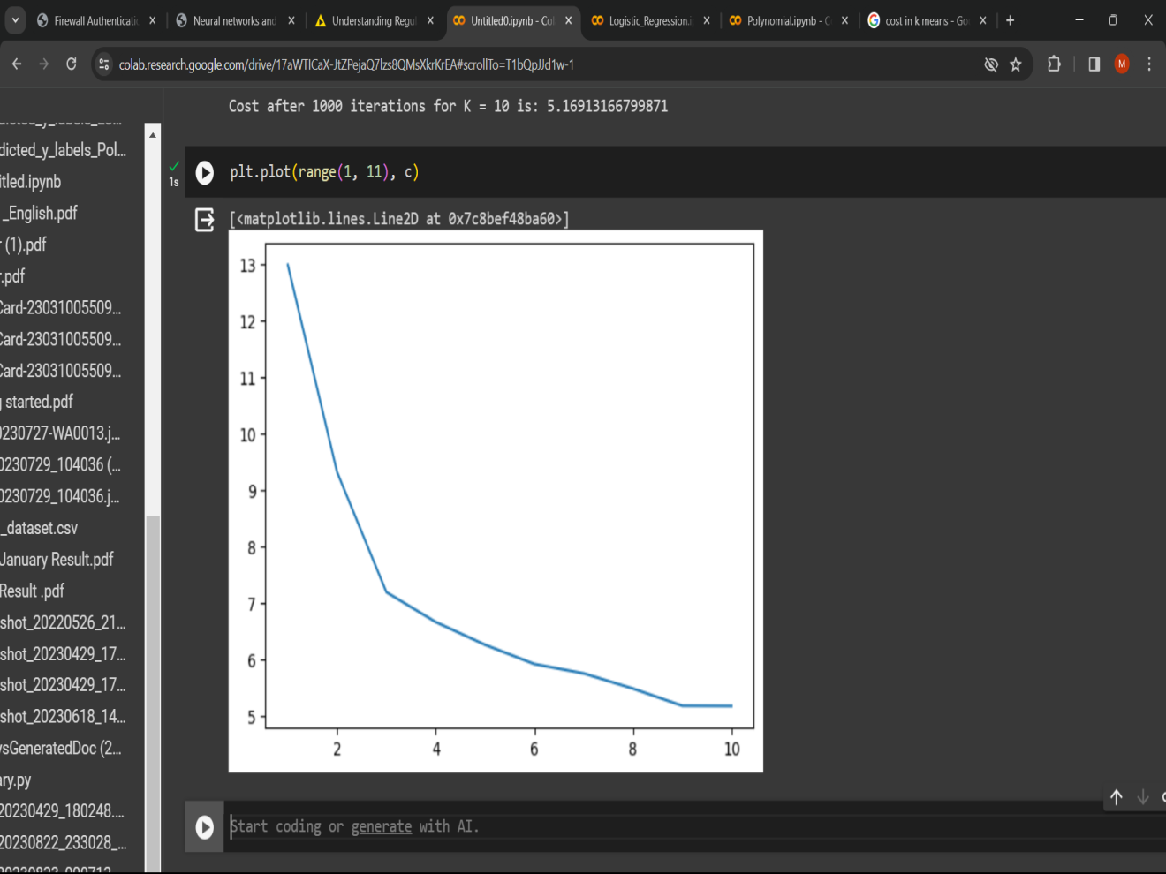
Graph of cost vs k. We can notice that there is a clear elbow at k=3.

Slide 21
Overall Changes
At first I made different functions for different things. Then I combined everything into one class for every algorithm.
I comment out all the previous codes of mine that I mentioned in my report.
I combined all the algorithms into one .py file whose name is mlbootcamp.

